Slide 1
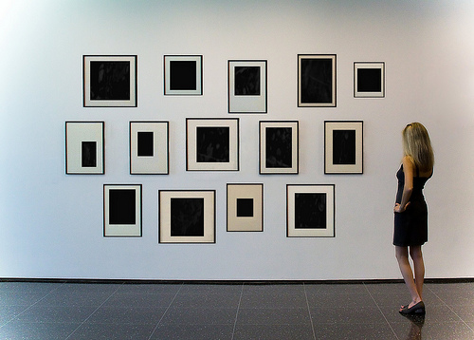

Choosing the right image format

Slide 2
What will be briefing looking at:
- Introduction - Strengths & Weaknesses and comparison between file formats:
The GIF Format
The JFIF/JPG/JPEG Format
The TIFF Format
The PNG Format

Slide 3
Image File Formats: Pro and Cons

Slide 4
Image File Formats: Pro and Cons
GIF:
PROS:
suitable for logos, flat areas of color with well defined regions
suitable for icons with few colors
support for transparency
suitable for small animations
CONS
Cannot do alpha transparency
Outline of solid colour if on gradient background

Slide 5
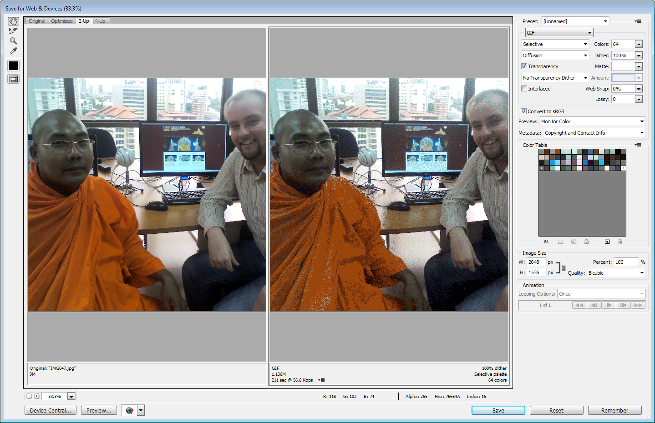
Image File Formats:
Gif Vs JPEG Compression

Slide 6
Image File Formats: Pro and Cons
JPG/JPEG:
PROS:
suitable for images, high details & quality pictures
uses lossy compression
it is the most used graphic file format
used in design and photography industry – it is likely to see nature photos in JPG file format
it is good when you are willing to drop quality from a picture for the sake of file size
CONS:
it does not support transparency
it is not suitable for logos and icons because it doesn’t have transparency and it can generate a bigger file size for small resolution images.

Slide 7
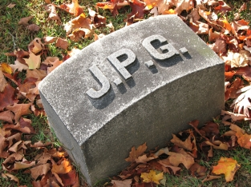



Quality: 100 Size (bytes): 83,261 Compression ratio: 2.6:1 Comment: Extremely minor artifacts
Image File Formats:
Artifacts on JPEG Format
Quality: 50 Size (bytes): 15,138 Compression ratio: 15:1 Comment: Initial signs of subimage artifacts
Quality: 25 Size (bytes): 9,553 Compression ratio: 23:1 Comment: Stronger artifacts; loss of high frequency information
Quality: 1 Size (bytes): 1,523 Compression ratio: 144:1 Comment: Extreme loss of color and detail; the leaves are nearly unrecognizable

Slide 8
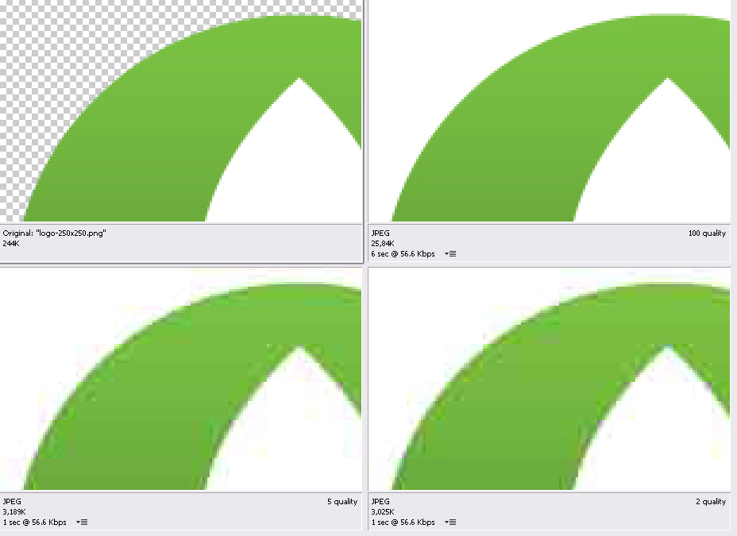
Image File Formats:
Artifacts on JPEG Format

Slide 9
Image File Formats: Pro and Cons
PNG:
PROS:
24bit color / 8bit color(256 colors)
suitable for flat areas of colors, logos, transparent or
semitransparent images
suitable for icons
it has alpha channel transparency which is more advance than GIF’s transparency
proposed as replacement of GIF by World Wide Web Consortium
CONS:
it is wise to avoid using PNG with big photos and images with details because of the big generated file size
in different situations it has bigger file sizes than JPG

Slide 10
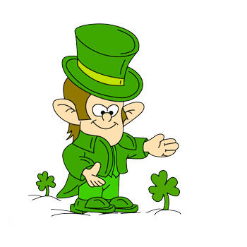
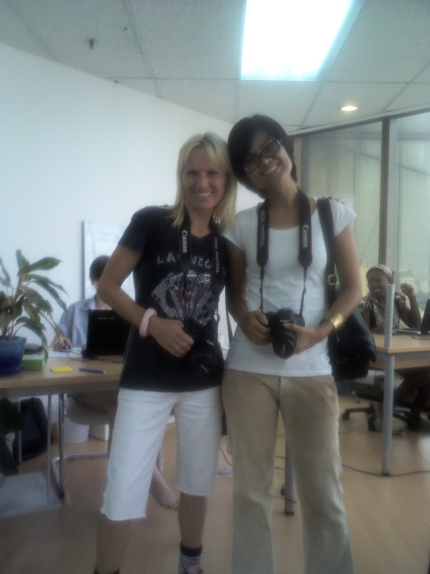

Image File Formats: Pro and Cons
PNG Vs GIF Vs JPG:
Use PNG if you need
100 % Quality and
See through effects
Use GIFs if the image is blocks of colour or needs animating
JPGs are used for photographs or anything with lots of colour

Slide 11
We hope you enjoyed this presentation and that now you know something more about these graphic formats.
Thank you for watching it!

